Slide 1




ANZSOM OHN Nurse Recognition Program
27th March 2026

Slide 2
Background
ACOHN Competency Standards established 1991
2012 – established Nurse Liaison role in Executive
ASM 2017 – initial workshop
ASM 2018 – meeting involving ANMF
2019 – formally established Nurse Strategy Group
2020 – worked with other stakeholders in tertiary education and AIHS. Resulting in decision to focus on competencies as the starting point
2021-22 – Standard development
March 2023 – Competency Standards and Recognition Program launched

Slide 3
Why a Recognition Program?
To establish professional recognition for occupational health nurses
To sustain a high standard of professional practice among occupational health nurses
To establish ANZSOM as the lead body for OHN recognition and development
To support employers in securing suitably qualified and skilled OHNs
To facilitate access to suitable postgraduate training for nurses seeking a career in occupational health nursing

Slide 4

Key features of the Recognition Program
ANZSOM members only – a key benefit of being involved in ANZSOM
Robust and transparent governance process – overseen by a voluntary Governance Committee comprising experts in education and professional certification
Robust assessment process based on Guidelines and agreed Standards
Provides recognition for 3-years
Enables recognized OHN’s to identify themselves and promote their expertise

Slide 5
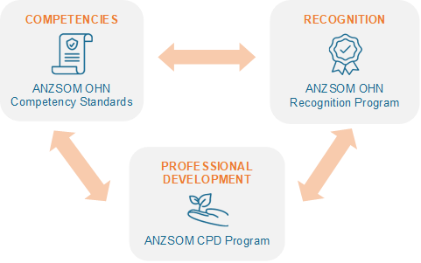
ANZSOM professional framework for OHNs

Slide 6

Competency standards for occupational health nurses
Domain 1: Legislation, standards, codes of practice and guidelines
Domain 2: Principles of occupational health nursing
Domain 3: Collaboration and communication
Domain 4: Prevention of work-related illness and injury
Domain 5: Managing injury and illness and return to work
Domain 6: Promoting worker health and wellbeing
Domain 7: Quality and continuous improvement

Slide 7
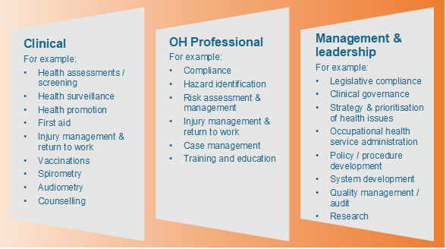
Scope of OHN practice

Slide 8
Recognition requirements
Professional nursing qualifications
Current professional nursing registration
Current employment in the field of occupational health
Competency in occupational health nursing demonstrated through
Additional qualifications and training
Professional experience
Referees
Self-assessment against the ANZSOM OHN Competency Standards with supporting evidence
Notes:
.

Slide 9
Currently
Currently 5 Recognised OHN since 2023
19 OHN in progress,
OHN Membership has increased
20% of OHN in ANZSOM

Slide 10






www.anzsom.org.au/join
www.anzsom.org.au
secretariat@anzsom.org.au
1300 666 515
linkedin.com/anzsom
fb.com/anzsom
@anzsom_inc

