Slide 1
CONNMO Presentation I 27 March 2026
Successful Collaborations
Advocacy for Nurse-Led Care
Dr Kathryn Zeitz – Chief Executive Officer

Slide 2
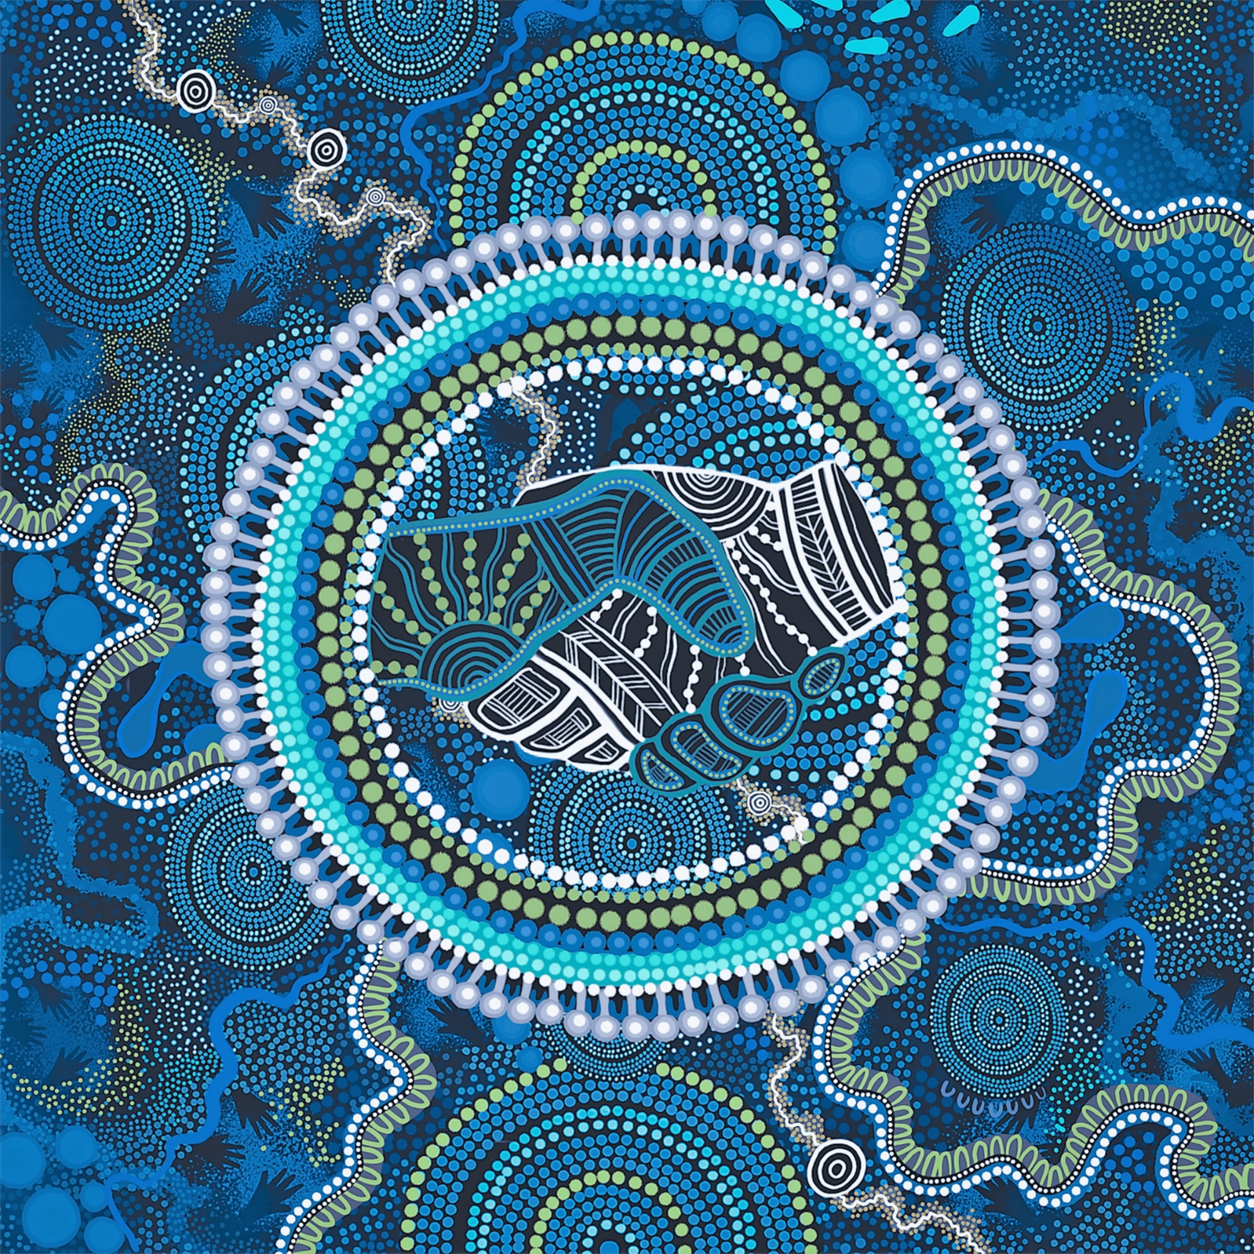
Acknowledgement of Country
In the spirit of reconciliation, ACN acknowledges the Traditional Custodians of Country throughout Australia and their connections to land, sea, and community.
We pay our respects to elders past and present and extend that respect to all Aboriginal and Torres Strait Islander peoples today.
Artwork by Kristie Peters, Yurrudhamarra Creations, NAIDOC artist of the year 2021
Notes:
I would like to begin by acknowledging the Traditional Custodians of the beautiful lands on which I am presenting today, the Ngunnawal people. I pay my respects to their Elders past and present and recognise their continuing connection to land, waters and culture. I also acknowledge and pay my respects to Aboriginal and Torres Strait Islander peoples joining us today from other lands and countries across Australia. As nurses and health professionals, we recognise the deep knowledge, strength and resilience of Aboriginal and Torres Strait Islander peoples, and the importance of culturally safe, respectful and inclusive health care for all.
This piece was commissioned by ACN and produced by Kristie Peters as part of ACN’s Reconciliation Action Plan.

Slide 3
ACN Successful Collaborations
Objectives
Share ACN's strengthened advocacy efforts, leveraging off our collaborations, to elevate nurse-led model of care across Australia
Describe some of the tools we used including storytelling, and strategic media engagement

Slide 4
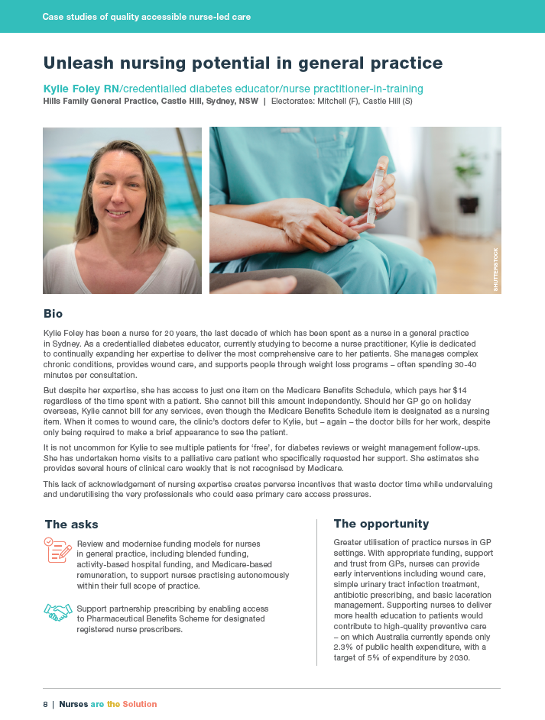
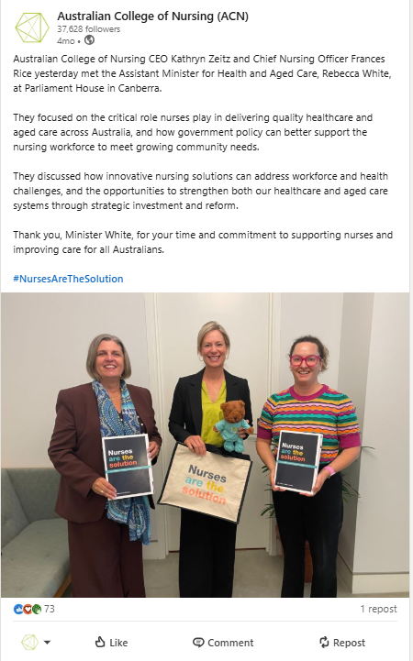

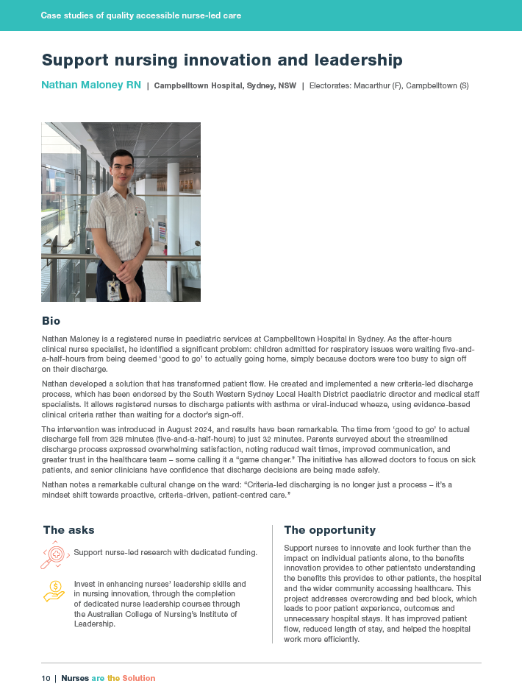
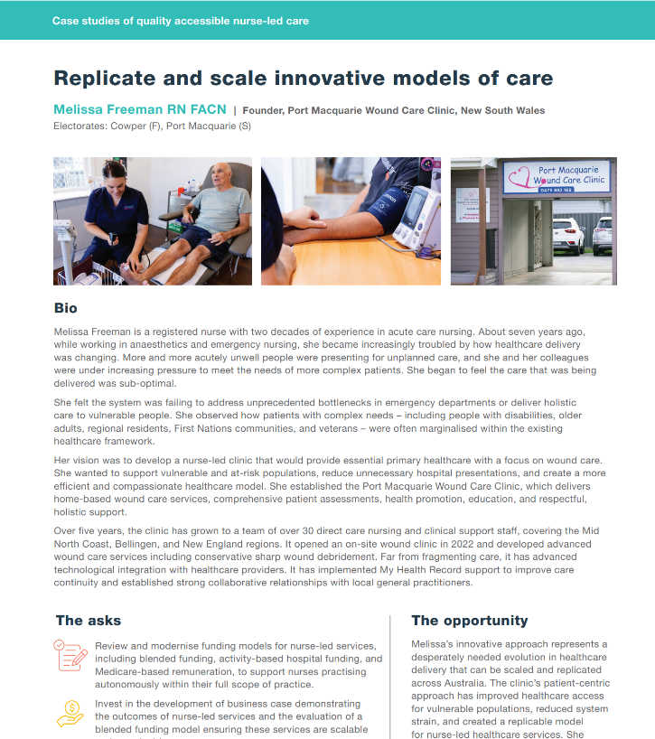
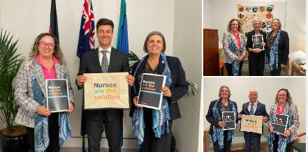

Case studies of quality, accessible nurse-led care
Working with nurses’ stories brings our advocacy to life

Slide 5
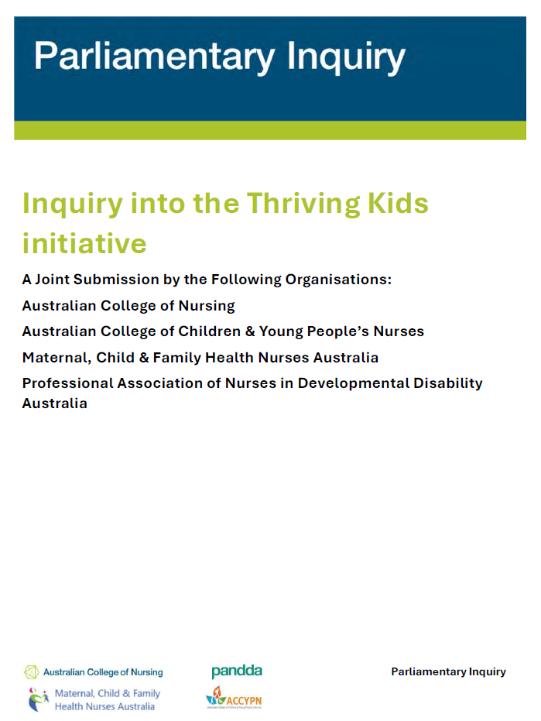
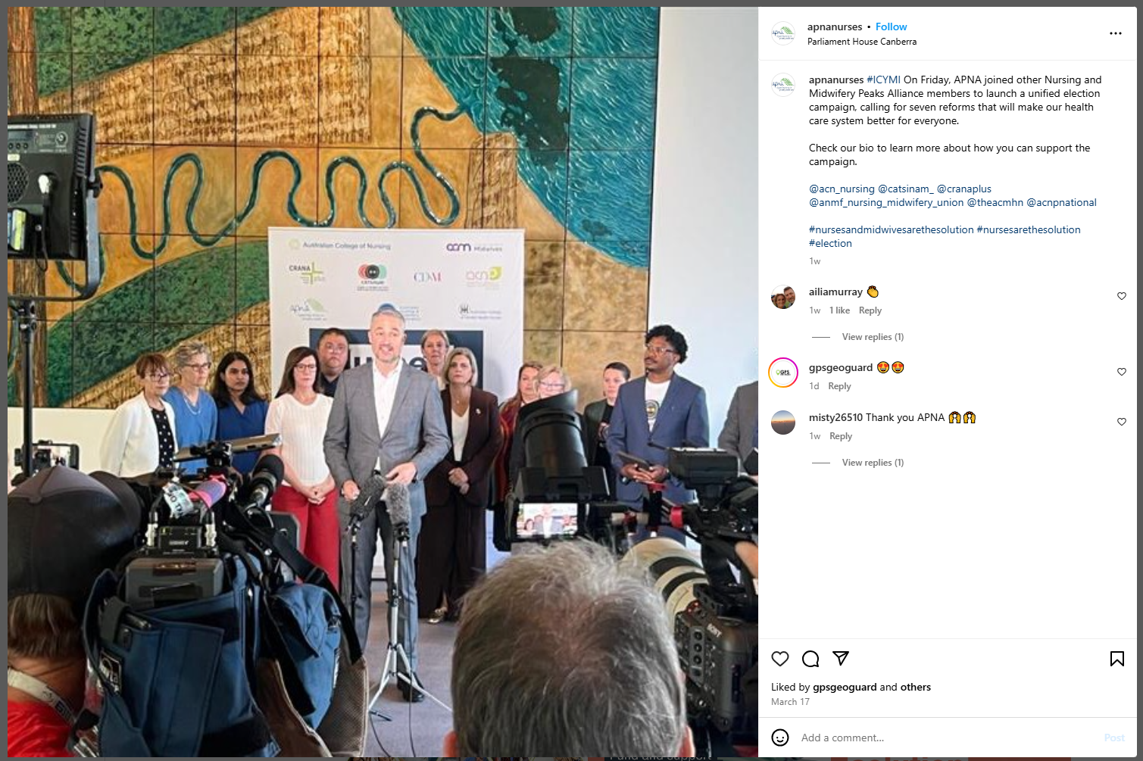

Professional collaborations
We will go further together
Coalitions reduce the political barriers for reform

Slide 6
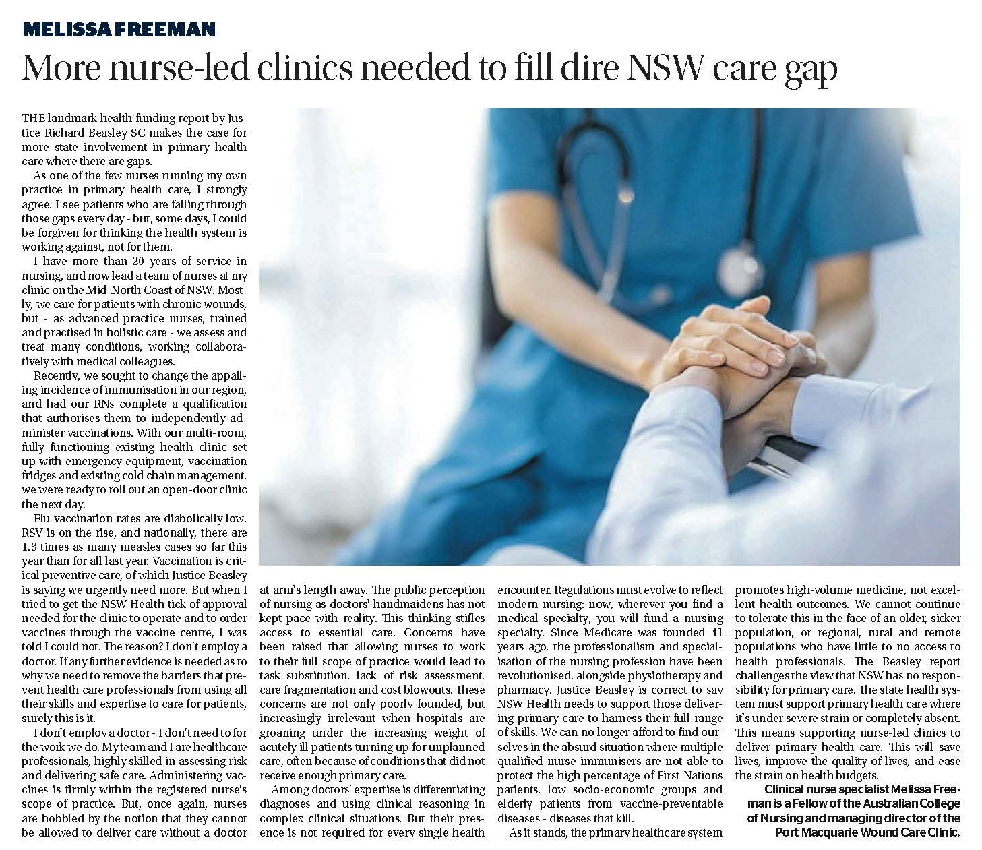

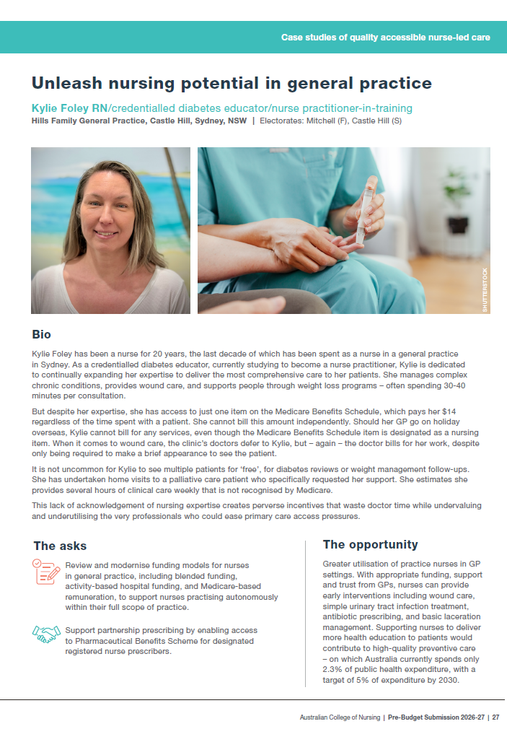
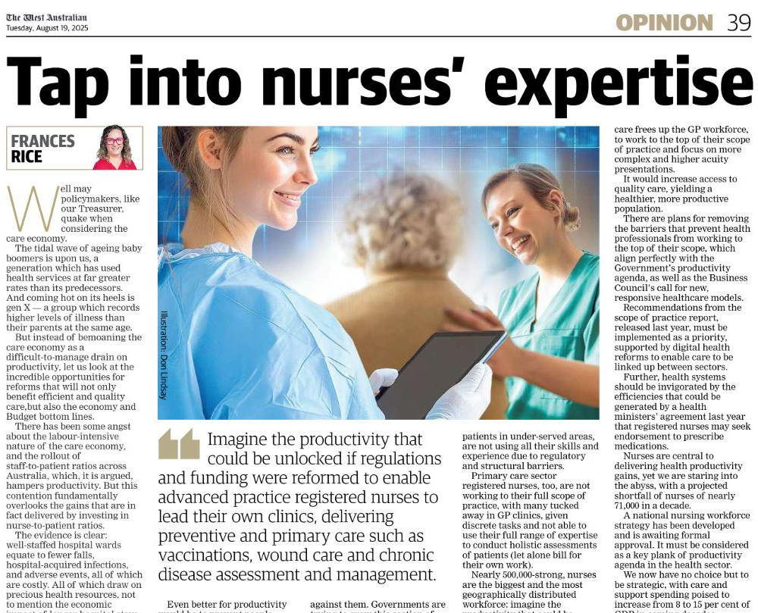
Pre Budget submission collateral for building a nursing-centric health agenda
ACN opinion pieces published in The West Australian (August 2025), and The Newcastle Herald (May 2025).
The ACN Pre-Budget Submission also included the case studies of nurse-led care and initiatives.

Slide 7
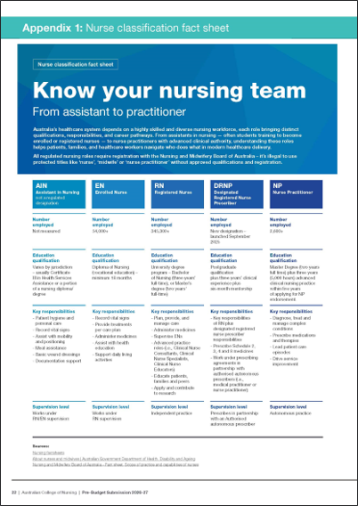
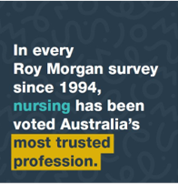
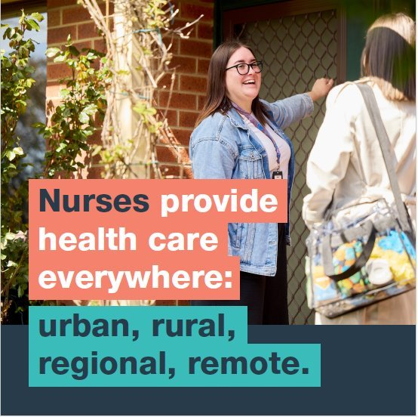
Part of the task is to explain nursing

Slide 8
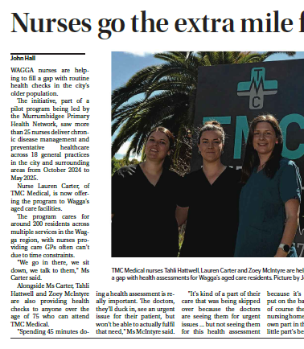
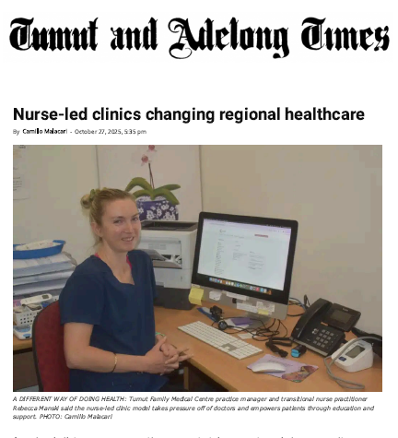
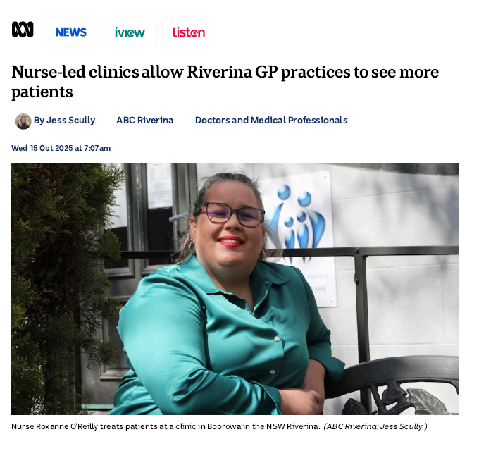
Coordinated Media and Digital Campaigns
Working with nurses’ stories brings our advocacy to life
Tests and builds our case in the public sphere.
Enhances public and policymaker understanding of nurses and their roles and potential.

Slide 9
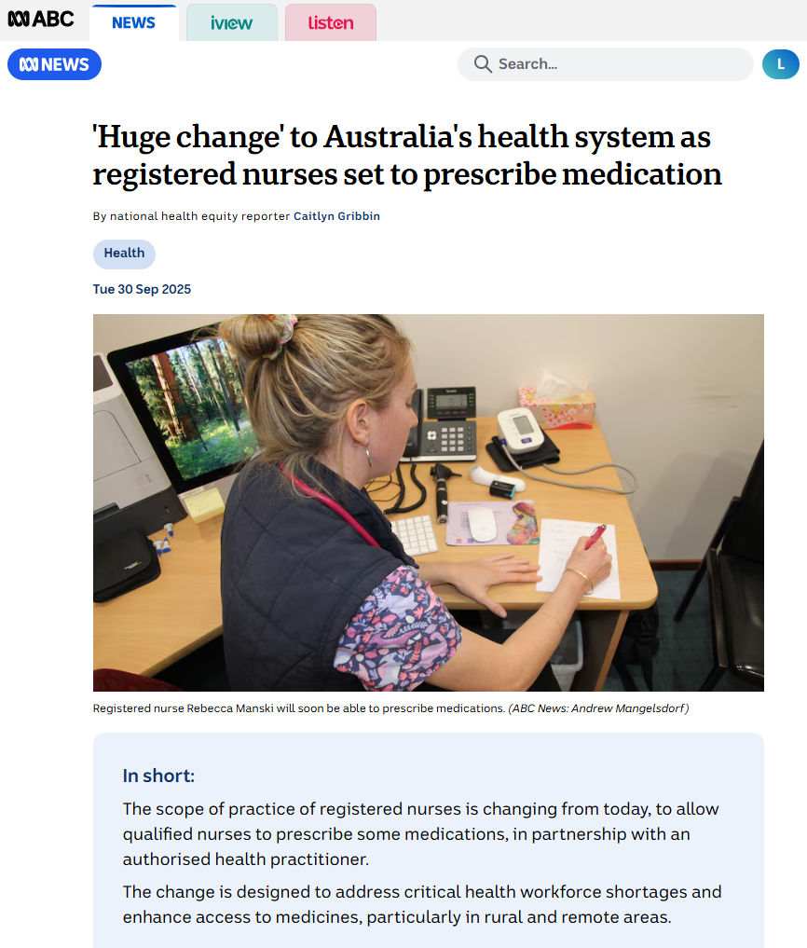
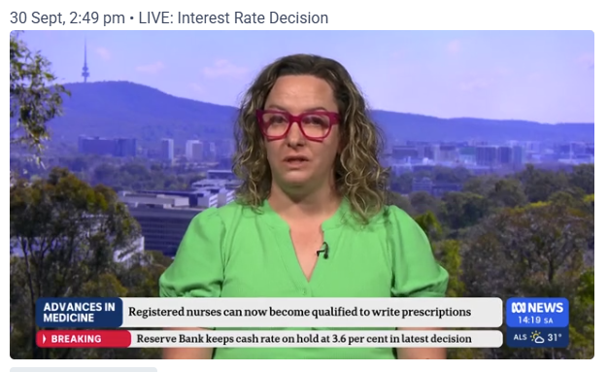
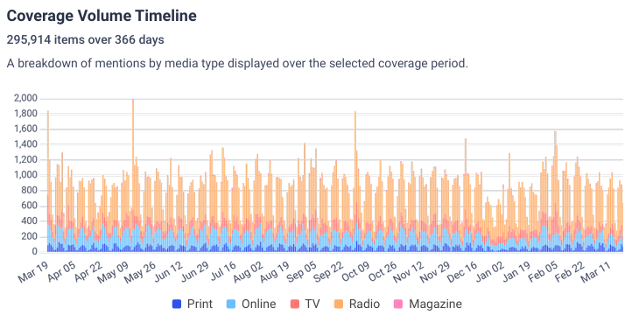
Coordinated Media and Digital Campaigns Leading the agenda
ACN led a spike in media mentions of the word ‘nurse’.
The designated RN prescribing standard coming into effect was/is an opportunity to advocate for the profession.

Slide 10
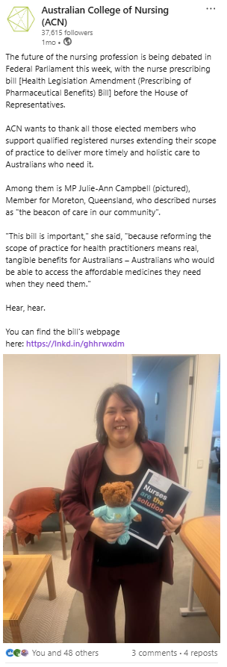
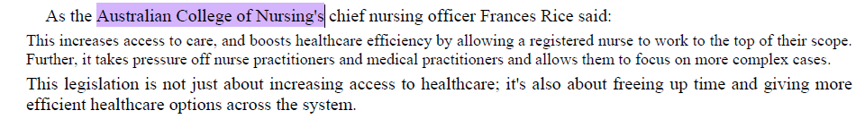
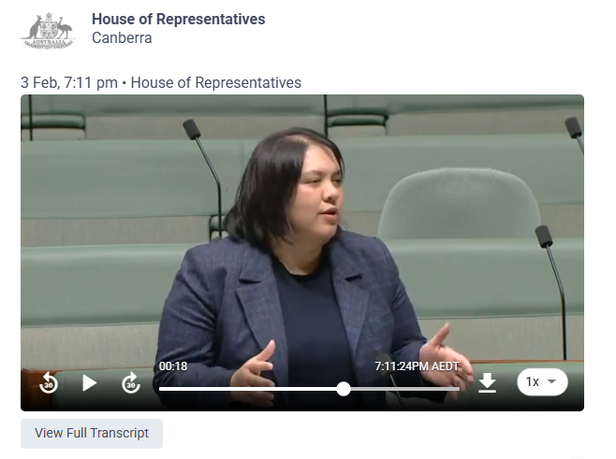
Coordinated Media and Digital Campaigns
Our case is being supported by parliamentarians
ACN followed up with gratitude
Julie-Ann Campbell, Labor MP for Moreton (Qld) speaking on the Health Legislation Amendment (Prescribing of Pharmaceutical Benefits) Bill 2025

Slide 11

Expected outcomes
A stronger united professional
Lead policy development that benefits nurses and midwives and the people in their care
Retention of nursing workforce
Attracting new people to the profession
Greater respect for nurses in the health and political spheres
An equal place for nursing in political discourse - up there with doctors and pharmacists
Transformation of public respect for nurses into political influence
Nurses at Royal North Shore Hospital, Sydney – photographed by ACN in 2025.

Slide 12
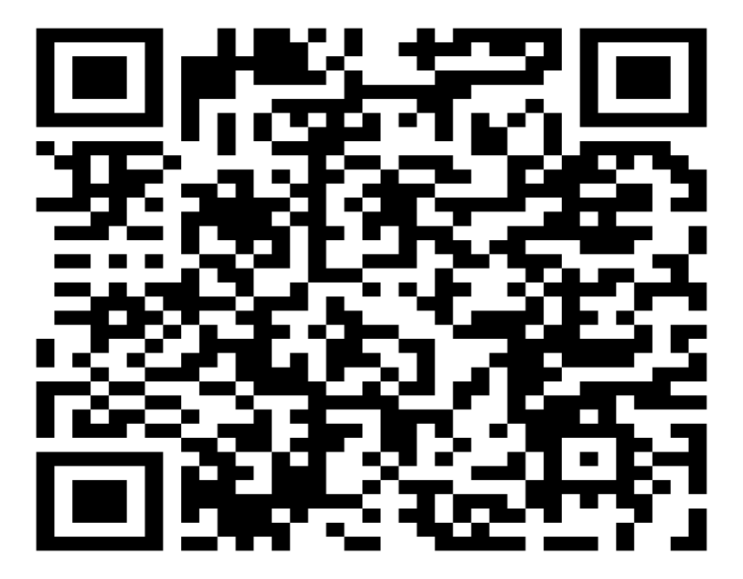

We are keen to work with you
Partnering together will provide the foundations to advance our collective advocacy efforts, for the good of our profession, the nursing and midwifery workforce and the communities we serve.
ACN Pre-Budget Submission 2026-27

